Slide 1
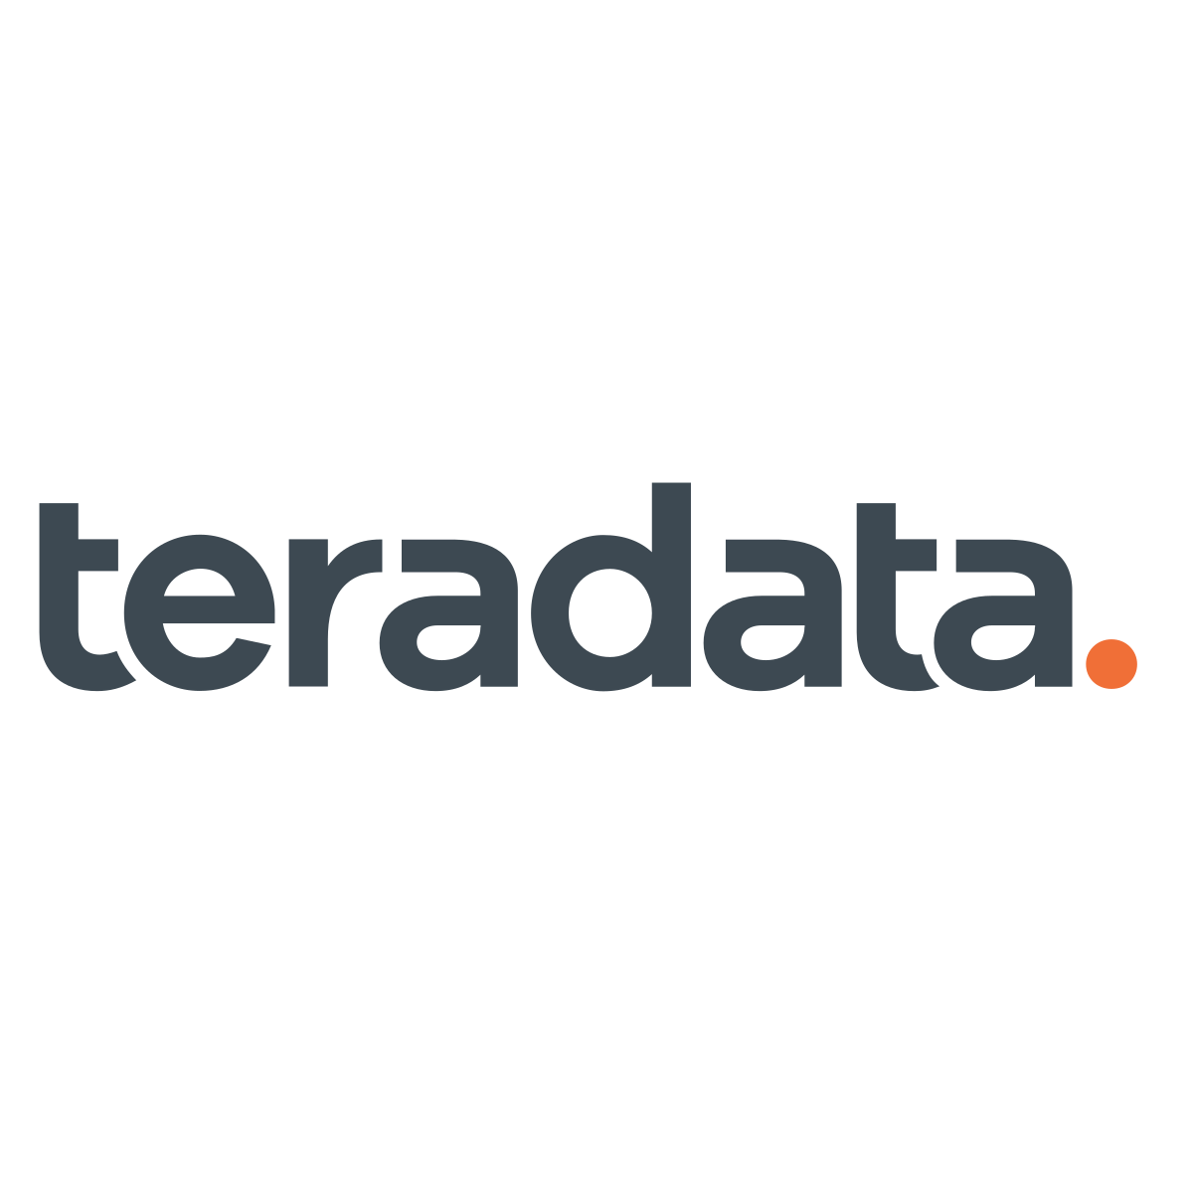


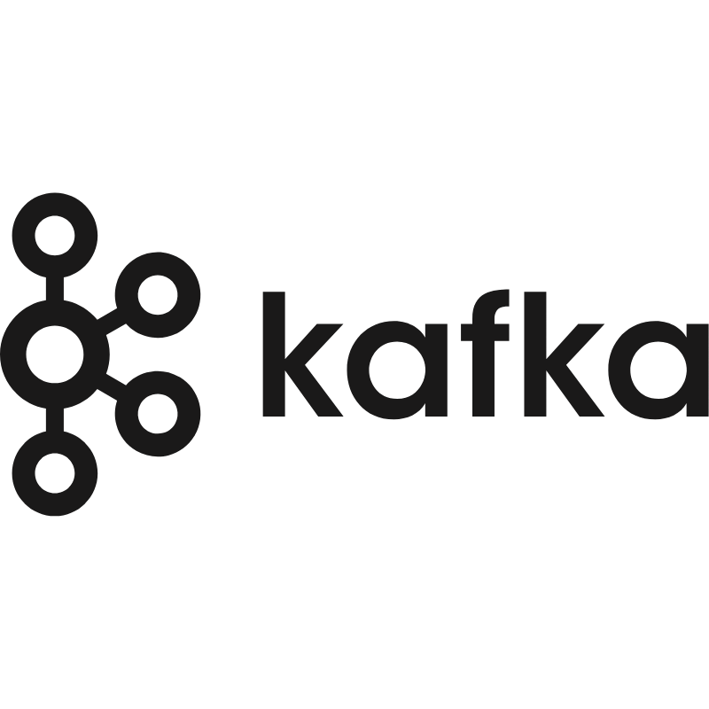
2. Migration – Test Automation
OUR approach
Our automated testing approach for history and daily incremental load uses table-level validations at each hop ensuring data completeness and accuracy during data transfer. We use automations to perform pre-defined validations at scale between Teradata and Snowflake
TRAVIS
Regression Suite
Falcon Framework
Ingestion Framework
Validations between TD & SF
DDL Validations
Record count validation
KPI Validations
GL Balance
Column level summary Checksum validation
DDL Validation
History Data Load
AWS S3
Count Validation
AEDL Framework
KPI Validation
Validations between U01 & U02 SF
DDL Validations
Count Validations
Parallel Testing
Sample Data validation for tables with Huge Data
KPI Validations
GL Balancing across all tables of subject area
Target Table Data from TD to SF
Target Table in U01
Incremental Load
GL Balancing across tables
SQL Validation
Source Tables in sync between TD & SF
ETL Pipeline on U02 SF
Security Views Validations
Legacy ETL Processing
TRAVIS
Tokenization Validations
Validations between Stream Source/ TD & SF
Schema Validations
Count Validations
KPI Validations
GL Balancing across all tables of subject area
Near Real Time Load
Utilize Regression Suite built during other Testing Phases
Converted Pipeline
AWS S3
** If it’s not feasible to compare against Teradata loads, validate target table data against Kafka source topics data/ source files

Slide 2
2. Migration – Test Automation Continued
DB Components
Historical Data
Code
(Incremental Data loads)
BI Reporting
OUR approach
We will leverage our industry leading testing accelerator to enhance speed and coverage for data quality validation of data objects, data and reports.
Scheduler
Production Go/No Go
Unit Testing
SIT
UAT
Prod Parallel
Validate DDLs of tables and views for data type
Data tokenization & encryption test
Validation of PHI, PII view creation
Data comparison with de-tokenized/decrypted sets
Test performance and execution time of jobs and downstream connections
100% data load from on-prem SIT for sanity & compatibility checks
100% production data load; match with legacy (Teradata)
Single execution during production migration for on-prem data validation.
10% sample data load
Cutover & Decommissioning
Syntax/code testing & dry run on target platform
E2E script execution to ensure feature retention
E2E script execution on prod data & on-prem comparison
Initiate scheduled pipeline runs alongside the legacy environment to ensure data consistency
Report connectivity to new database / schema
Reports can populate data
Compare report data with on prem using historical data
Validate KPIs for both historical and incremental
Validate KPIs for both historical and incremental
Incremental data pipeline testing
Scheduled E2E pipeline runs for UAT duration
Ongoing production support & monitoring during warranty window
E2E pipeline dry run

